Slide 1




Astronomy 1010 chapter 9
Clayton State University
Slides for Astronomy textbook from OpenStax
https://openstax.org/books/astronomy/

Slide 2
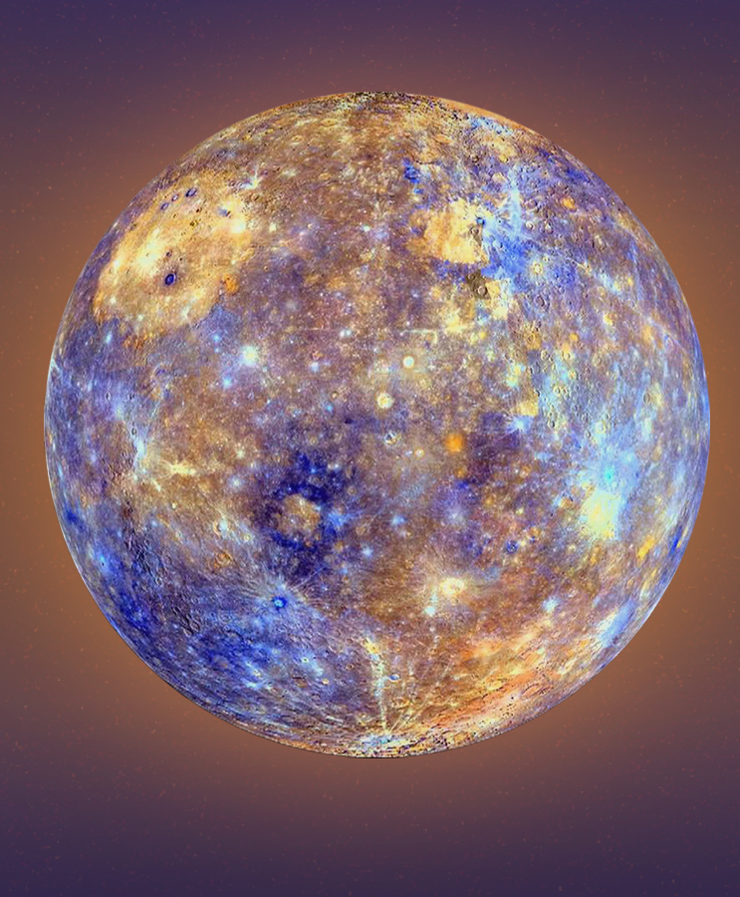
Inner planets: Mercury
Mercury is the smallest and innermost planet in the Solar System.
Its orbital period around the Sun of 87.97 days is the shortest of all the planets in the Solar System.
It is named after the Roman deity Mercury, the messenger of the gods (Hermes in Greek mythology).

Slide 3
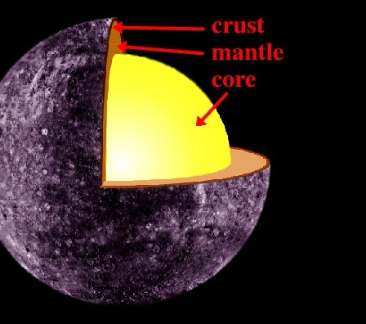
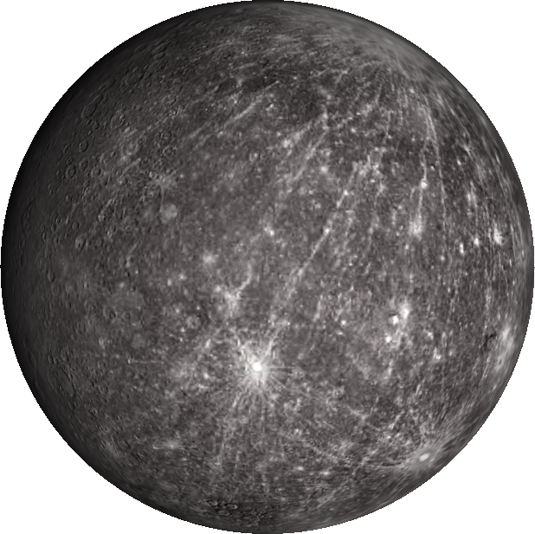
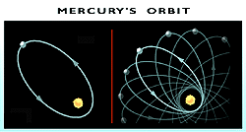
Inner planets: Mercury
Because of Mercury's elliptical—egg-shaped—orbit and sluggish rotation, the morning Sun appears to rise briefly, set and rise again from some parts of the planet's surface. The same thing happens in reverse at sunset.
100 K (−173 °C; −280 °F) at night to 700 K (427 °C; 800 °F) during the day across the equatorial regions
The polar regions are constantly below 180 K (−93 °C; −136 °F). The planet has no known natural satellites.
Mercury orbit presession was one of the observations that inspired and first supported the GR (General theory of Relativity)

Slide 4
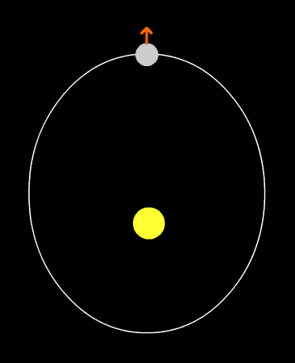
Inner planets: Mercury
Mercury is tidally locked with the Sun in a 3:2 spin-orbit resonance and rotates in a way that is unique in the Solar System.
As seen relative to the fixed stars, it rotates on its axis exactly three times for every two revolutions it makes around the Sun.
As seen from the Sun, in a frame of reference that rotates with the orbital motion, it appears to rotate only once every two Mercurian years.
An observer on Mercury would therefore see only one day every two Mercurian years.

Slide 5
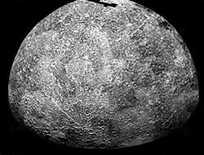
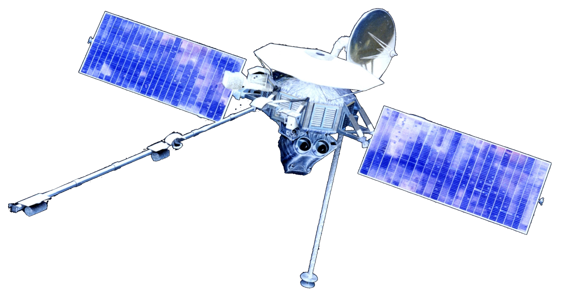
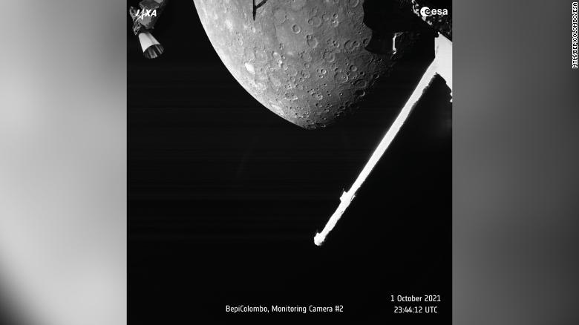
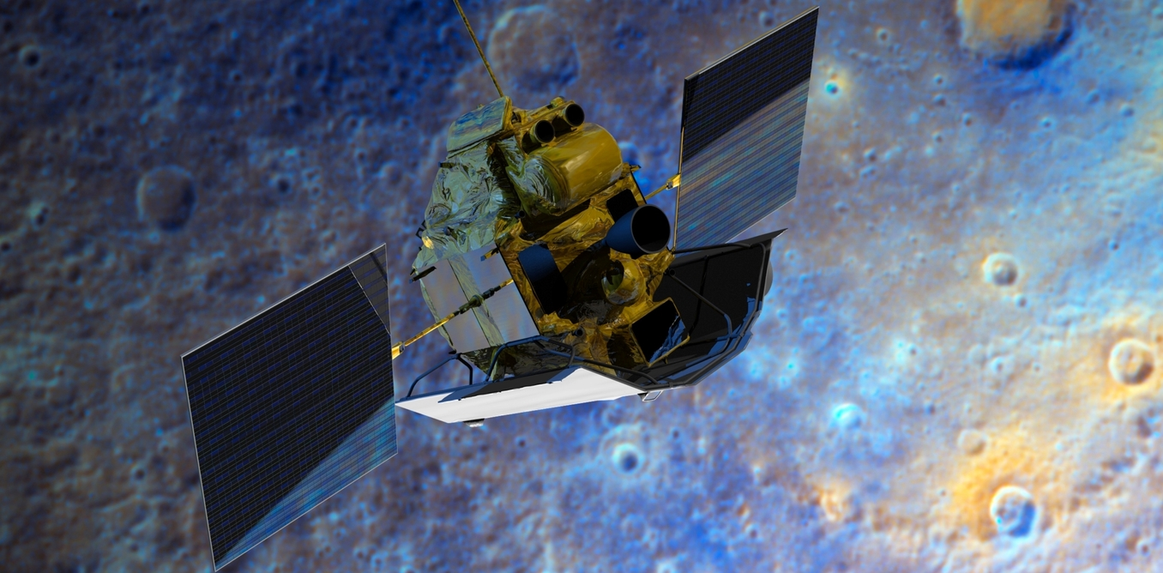
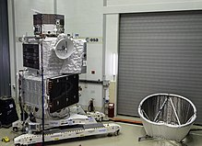
Inner planets: Mercury
Two spacecraft have visited Mercury:
Mariner 10 flew by in 1974 and 1975
MESSENGER, launched in 2004, orbited Mercury over 4,000 times in four years before exhausting its fuel and crashing into the planet's surface on April 30, 2015.
The BepiColombo spacecraft is planned to arrive at Mercury in 2025.
The BepiColombo mission made its first flyby of Mercury around 7:34 p.m. ET on Friday, Oct 1, 2021, passing within 124 miles (200 kilometers) of the planet's surface.

Slide 6
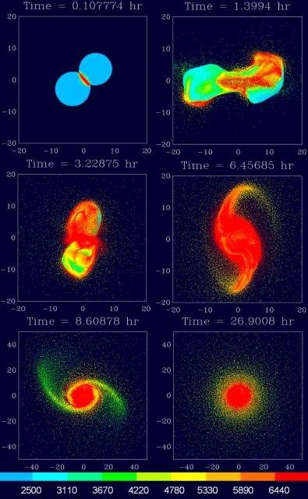
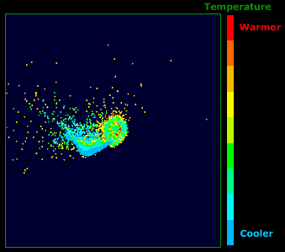
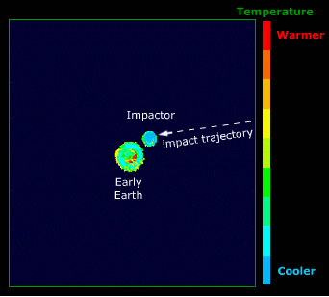
Inner planets: Earth + Moon
Formation of the Moon
Currently from impact from Thea
Explains composition and density

Slide 7
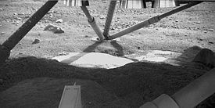
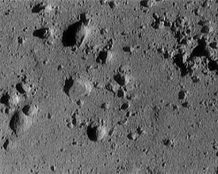
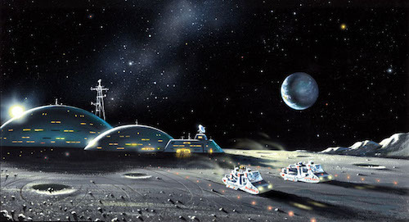
Inner planets: Earth + Moon
Lunar surface is covered by regolith
Its dust and fragments from thermal stress of the surface rocks (in shade = night cold)
Collects in craters under gravity
First thought that it can’t provide support for a person/satellite
In a science fiction novel by British writer Arthur C. Clarke “A Fall of Moondust’ (1961), a vessel designed to float upon the surface of the deep deposits of moon dust is suggested

Slide 8
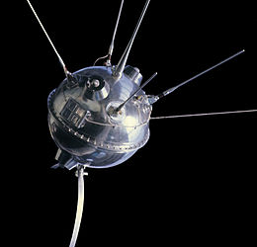
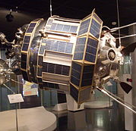
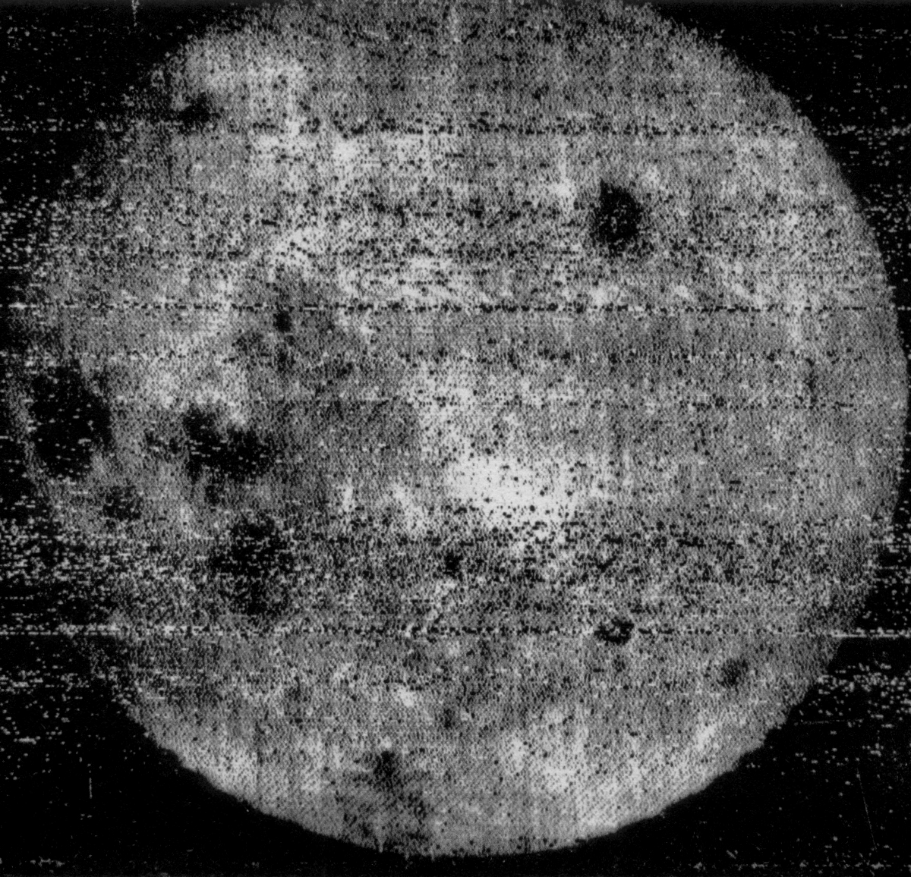
Inner planets: Earth + Moon
First missions
https://en.wikipedia.org/wiki/List_of_missions_to_the_Moon
First successful to reach and fly-by: Luna 1, Jan 1959.
Second successful to reach and impact Luna 2, September 1959. Delivered USSR pennant.
Third successful: Luna – 3. Oct 1959, fly-by, returned images of “dark side of the Moon”
Followed by US missions Ranger 7, Ranger 8, and Ranger 9.

Slide 9
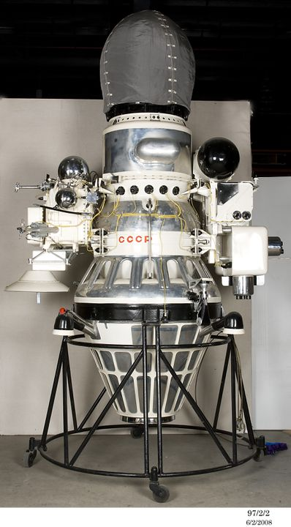
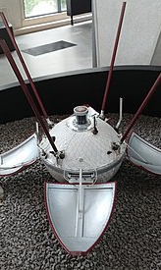
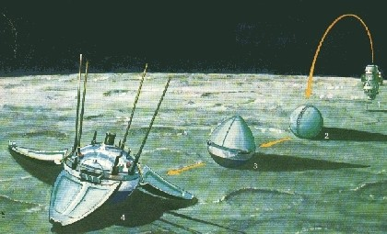
Inner planets: Earth + Moon
Testing the Dust
The objects in space vacuum ‘freeze’ to each other
Lunar dust can support landing?
Mission Luna-9 (USSR)
  First spacecraft to land successfully on the Moon. Touchdown on 3 February 1966 at 18:45:30 UTC
More info: https://en.wikipedia.org/wiki/Luna_9
Followed by Surveyor 1
Luna-13 (a soft landing on 24 December 1966) studied the mechanical properties of the surface (density and force for penetration via micro-explosives)

Slide 10
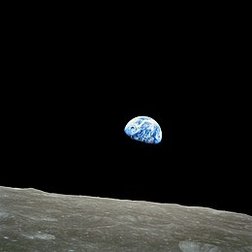
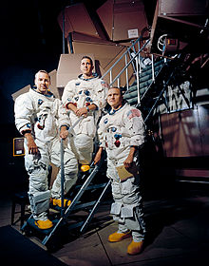
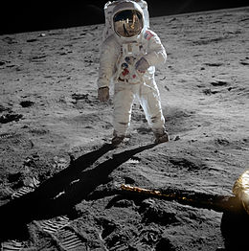
Inner planets: Earth + Moon
First man to reach the Moon
Apollo 8, USA
launched on December 21, 1968
Reached Moon in 3 days, 10 orbits around, return to Earth
Crew: Frank Borman, James Lovell, and William Anders
Followed by: Apollo 11, first landing!
July 20, 1969, at 20:17 UTC
Crew: Neil A. Armstrong, Michael Collins, Edwin E. Aldrin Jr.
Buzz Aldrin on the Moon as photographed by Neil Armstrong (Armstrong seen in the visor reflection). Wikimedia.

Slide 11
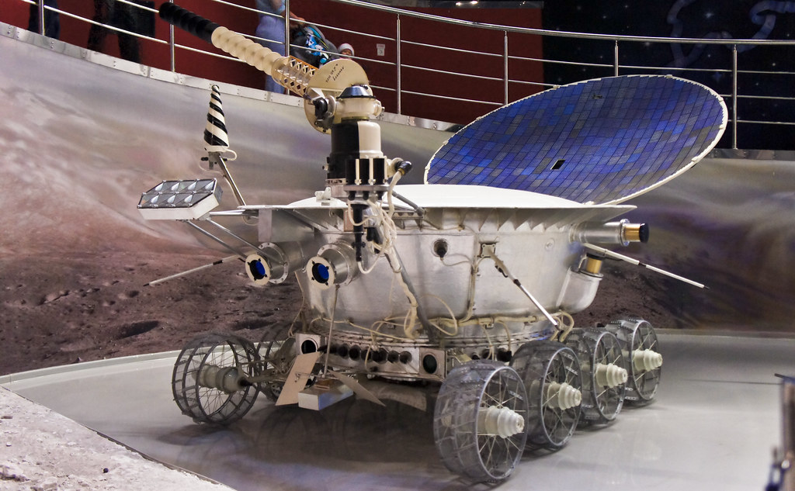
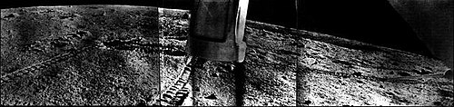
Inner planets: Earth + Moon
First Rover
Lunokhod 1 ("Moonwalker 1"), USSR
Landed on November 17 at 03:47 UTC, 1970
Reflective back – was used for measuring distance to Moon using a laser pulse, lost, found in 2010
https://en.wikipedia.org/wiki/Lunokhod_1

Slide 12
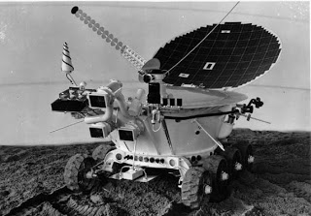
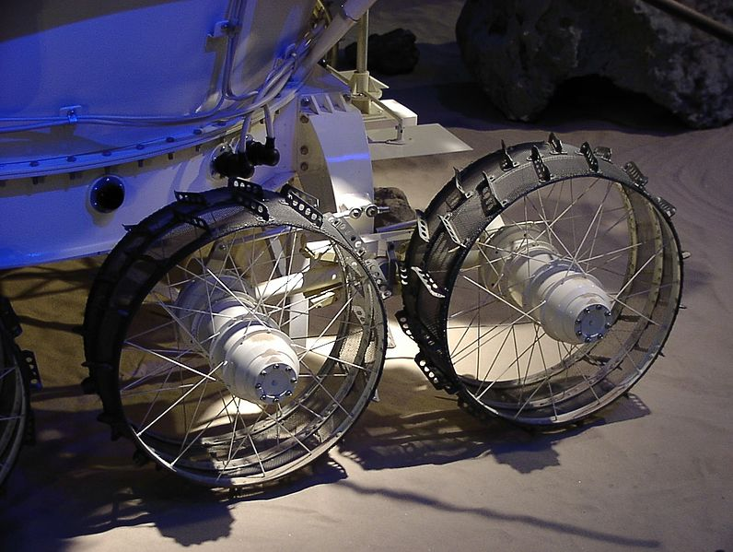
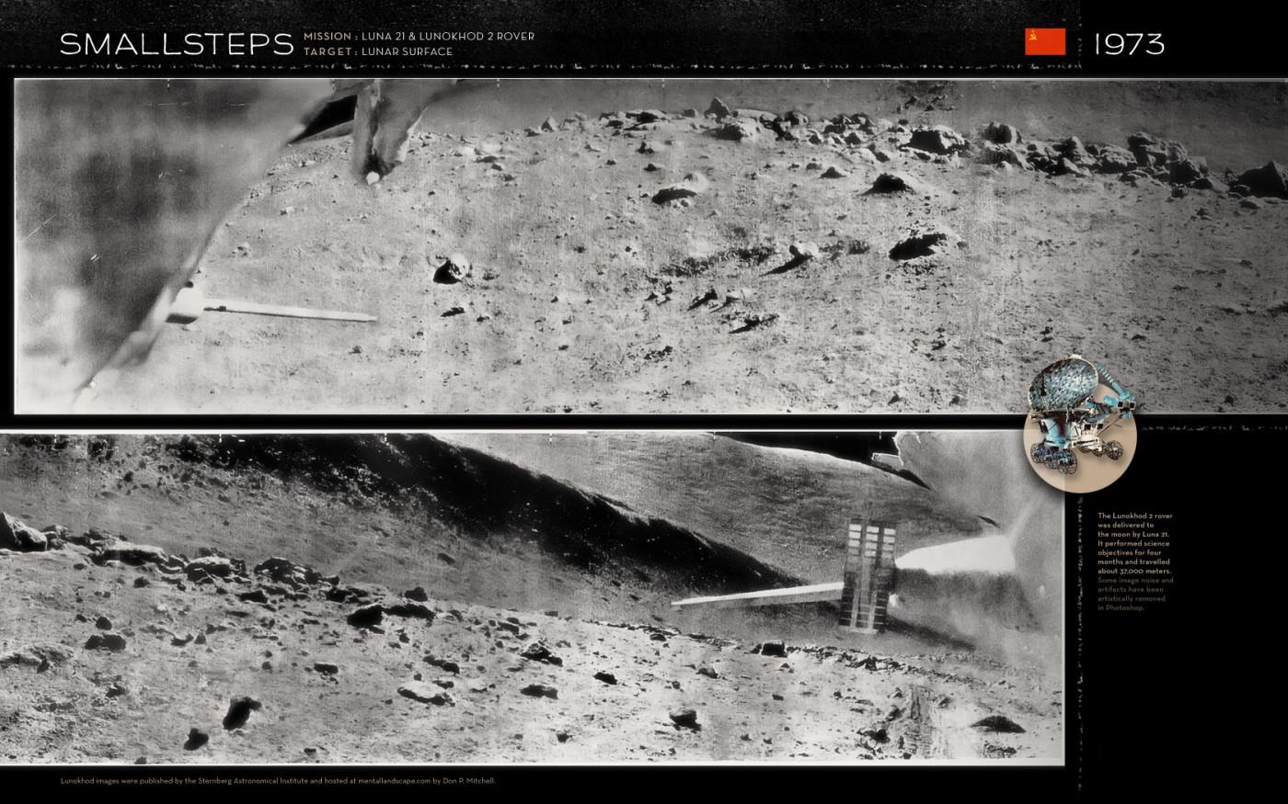
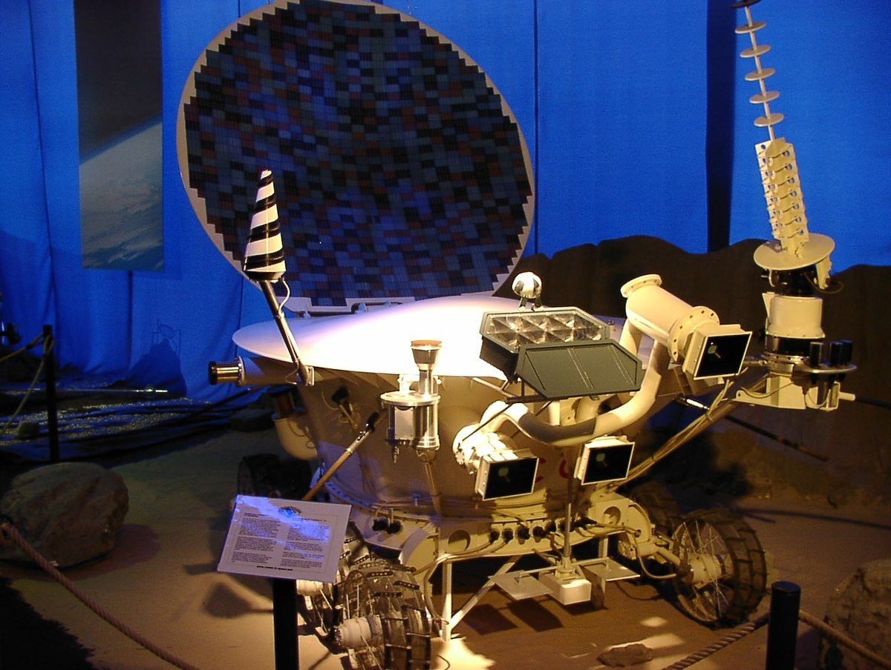
Inner planets: Earth + Moon
Second Rover
Lunokhod-2 (Moonwalker-2), USSR
Landing occurred at 23:35 UTC, 1973, in Le Monnier crater
Featured special ‘dust’ wheel design
Reflective back – still used for measuring distance to Moon using a laser pulse
This Photo by Unknown Author is licensed under CC BY-SA

Slide 13

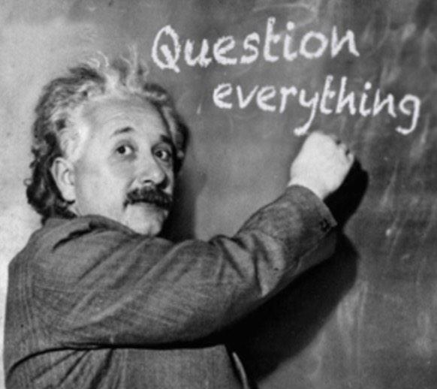
Any Questions?
Many other missions to the Moon followed, new ones are planned.

